Slide 1
Charged Weak Interactions of Quarks

Slide 2
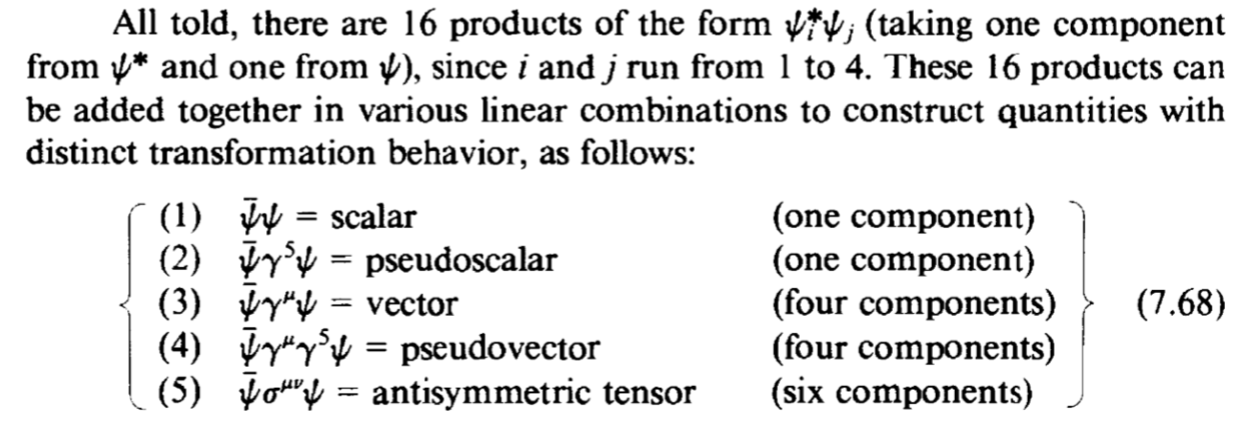
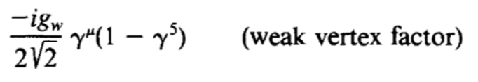
V-A Structure
Bilinear covariant
Axial vector
Interaction corresponding to spin1 particle is a linear combination of vector and axial-vector
V - A
Reason for helicity and parity violation

Slide 3
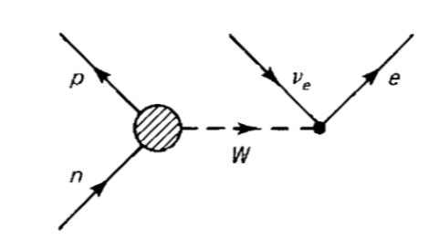


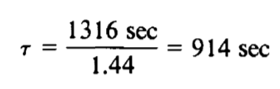

V-A Structure
Vertex is no clear
From many experiment,
Conserved Vector Current(CAC) Partially Conserved Axial Current(PCAC)
Cause a factor on lifetime

Slide 4
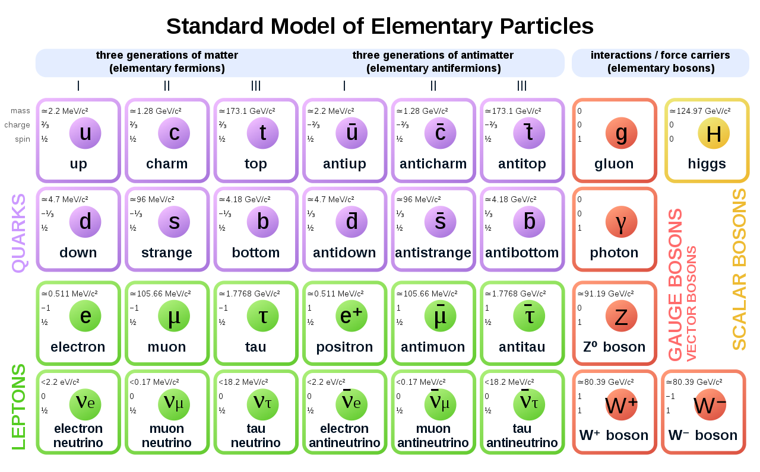
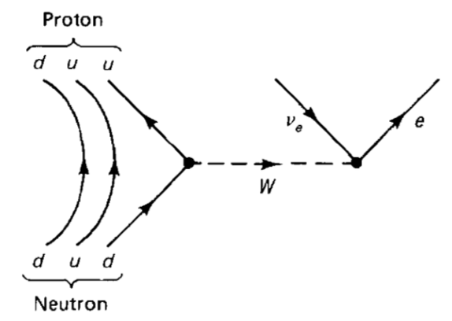
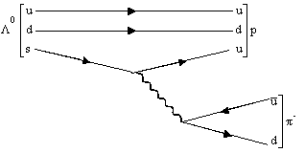




Weak interaction of Quarks
Lepton number conservation
Cross-generational coupling happens to quark
Weak interaction of leptons take place strictly within a generation

Slide 5
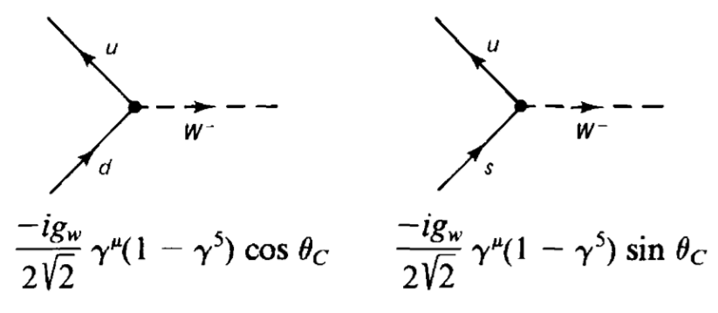

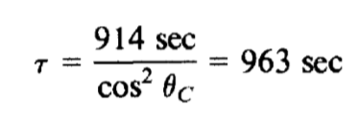
Cabibbo Angle
When coupling with quark, carries a factor
Generation changing one is weaker
Experimentally,
Cosθ=0.97 Sinθ=0.23
n lifetime

Slide 6
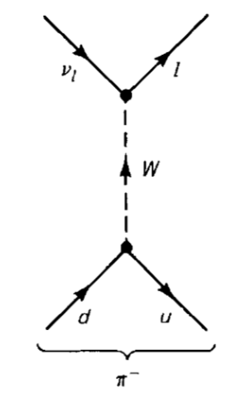
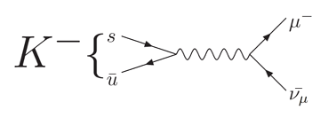
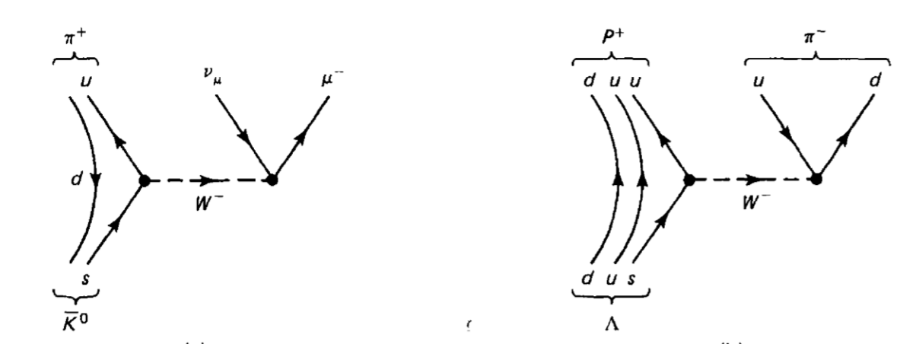
Decays
Leptonic decays
or
Semileptonic
decays
Nonleptonic
decays

Slide 7
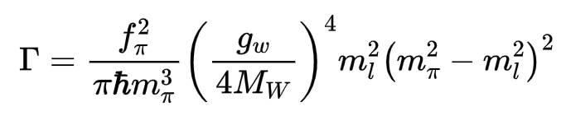

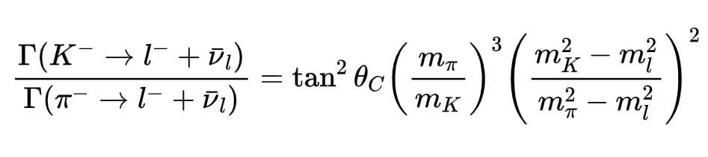
Leptonic Decays
Leptonic decays
or
Cosθ=0.97 Sinθ=0.23
Decay constant
Experiment gives Cabibbo angle 15.4°

Slide 8

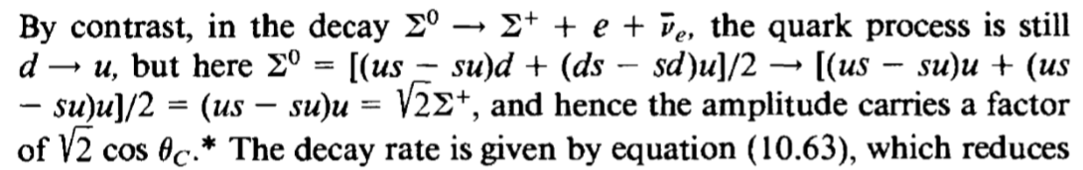
Semileptonic decays

Slide 9
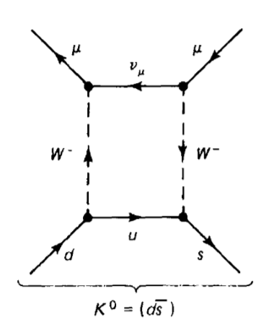
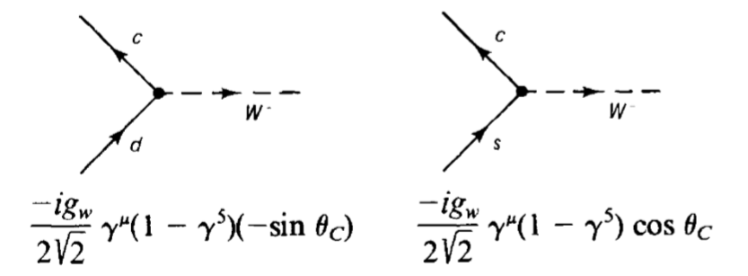
K0 Decays
Amplitude M should be proportional to CosθSinθ
Cosθ Sinθ
Experiment result is far lower?
1970 GIM mechanism introduce charm quark

Slide 10
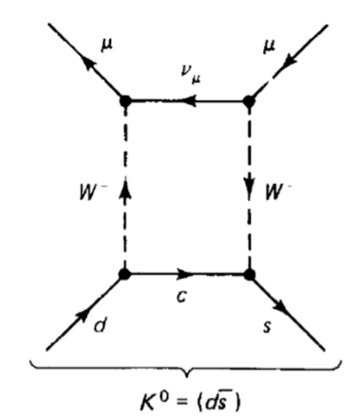
K0 Decays
1970 GIM mechanism introduce charm quark
-Sinθ Cosθ
Cosθ Sinθ
Amplitude M should be M1+M2-> A*CosθSinθ – B*CosθSinθ

Slide 11
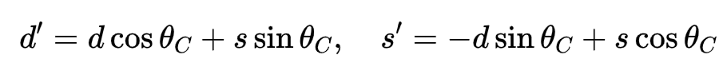
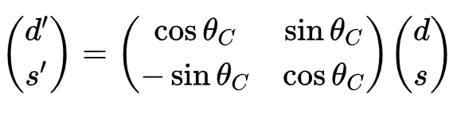
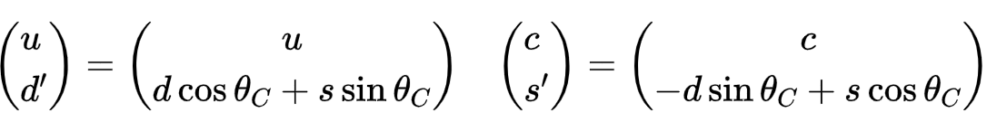
Cabibbo-GIM scheme
Weak interaction eigenstates
In matrix form
W couple with rotated state d’ s’
That is

Slide 12

Charm quark
Brookhaven National Laboratory and SLAC
1974 J/ψ meson ( )

Slide 13
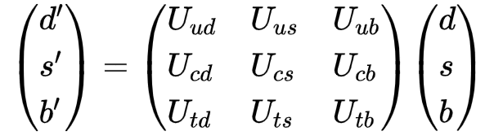
Bottom and Top
In 1973, Makoto Kobayashi and Toshihide Maskawa predicted the existence of a third generation of quarks to explain observed CP violations in kaon decay
K-M Matrix

Slide 14
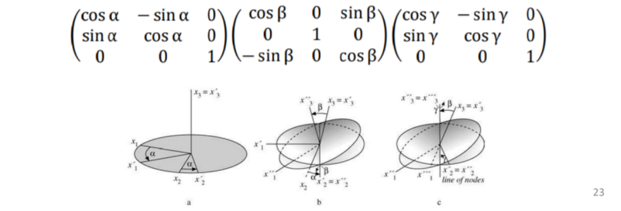

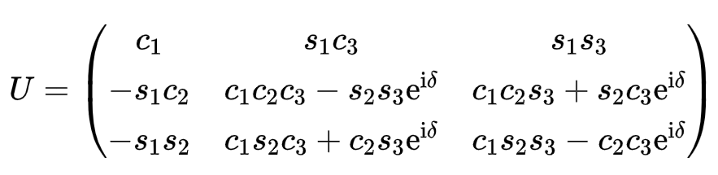



CKM Matrix
CKM Matrix
Recall that in group theory
Only 3 generalized Cabibbo angles required(θ1 θ2 θ3)

Slide 15
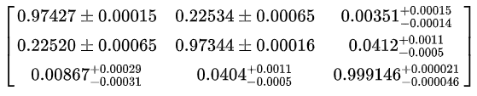
CKM Matrix
If θ2=θ3=0
Cabibbo-GIM scheme
However, experiment shows
Standard model can not predict CKM matrix

Slide 16
Neutral weak interactions

Slide 17
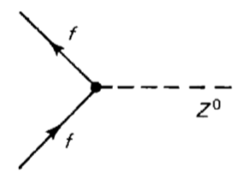



Z⁰ Boson
1985, Bludman suggested neutral weak interaction by Z0
Lepton number change
Quark generation change

Slide 18
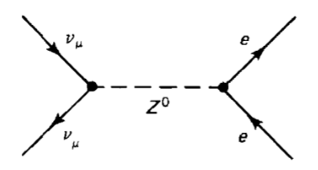

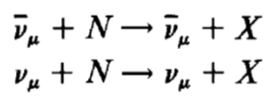
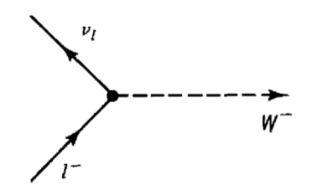
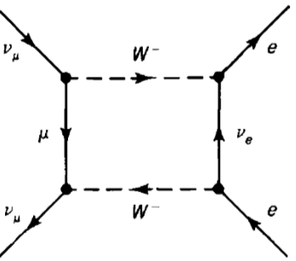
Z⁰ Boson
1973, First evidence in CERN
W+- only coupling same generation (anti)leptons and all quarks
High order process is possible (such as box diagram),while
Their cross sections were about a third as large as those charged events
Also help to establish the quark-parton model

Slide 19
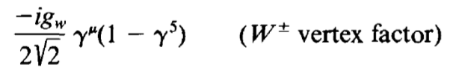

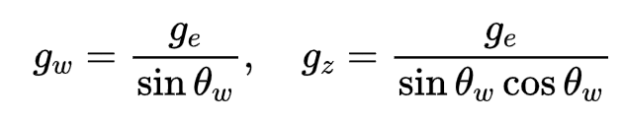
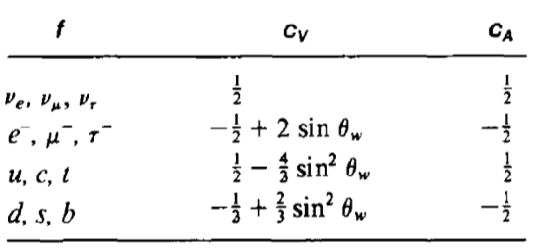
GWS model
Compare W and Z
gz is the neutral coupling constant
cV and cA depend on the quark or lepton involved
In GWS model, all determined by “weak mixing angle”

Slide 20

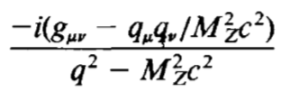

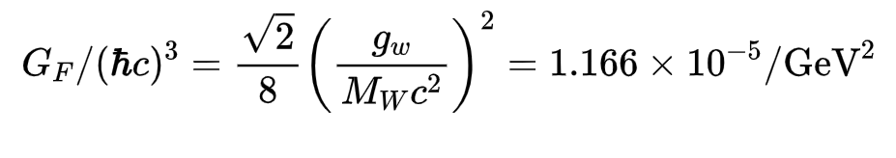
GWS model
Derivation of weak mixing angle is the main challenge of theory
Experiment gives
Propagator of Z
Finally,
These are the basic prediction of GWS model, giving mixing angle, from Fermi constant we can calculate W and Z mass

Slide 21
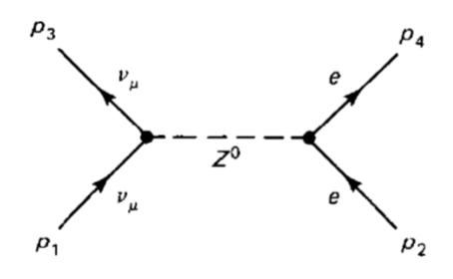

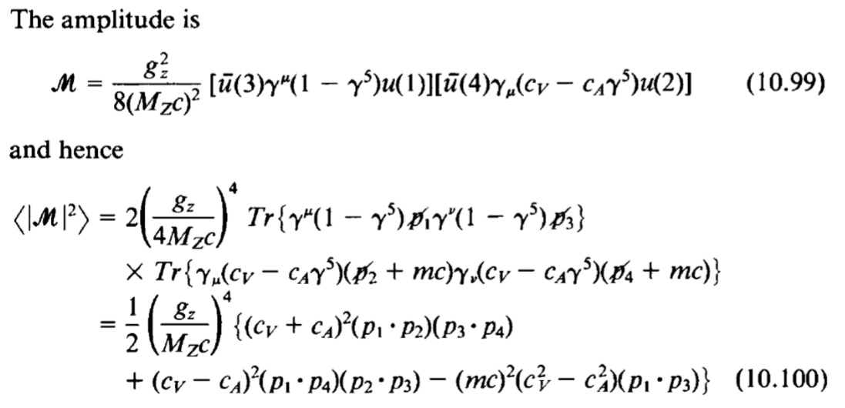
EXAMPLE Neutrino-Electron scattering

Slide 22
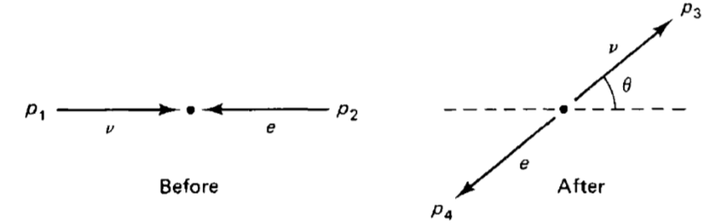
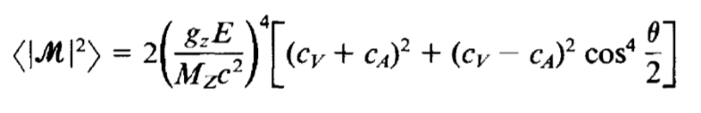
EXAMPLE Neutrino-Electron scattering
In CM frame and ignore electron mass
By using the result of two body scattering in CM frame

Slide 23
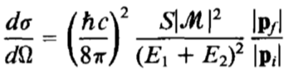
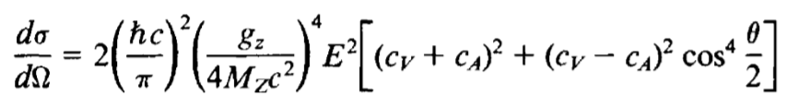
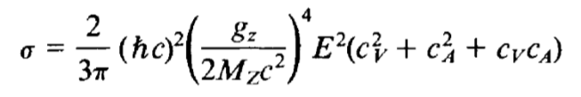
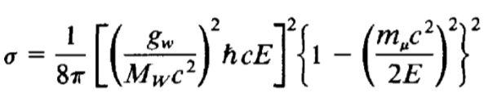
EXAMPLE Neutrino-Electron scattering
In CM frame and ignore electron mass
By using the result of two body scattering in CM frame
We get
Integrating over all angles
Insert cV and cA of electron, compare with inverse muon decay

Slide 24

EXAMPLE Neutrino-Electron scattering
Insert cV and cA of electron, compare with inverse muon decay
When E is >> mass of muon,
Experiment value is 0.08, good agreement!
Why it takes so many years to observed neutral current?
1.Masked by competing with QED process
2.Neutrino experiment is hard
3.High energy requirement because of the mass of Z

Slide 25
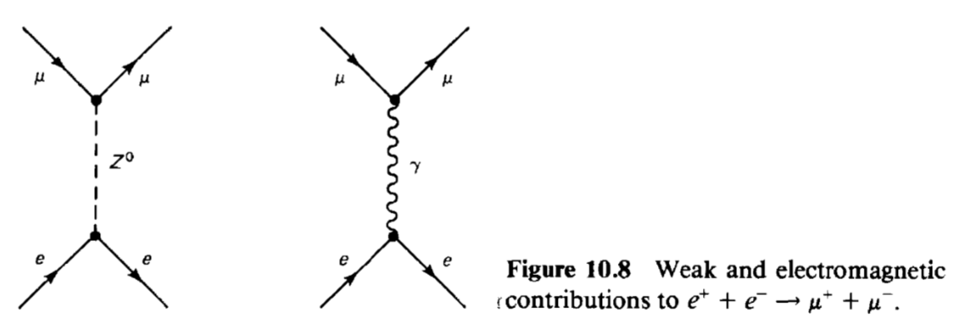
EXAMPLE Neutrino-Electron scattering
Why it takes so many years to observed neutral current?
1.Masked by competing with QED process
2.Neutrino experiment is hard
3.High energy requirement because of the mass of Z
Z couples everything the photon does
Every QED process contains weak interaction part!

Slide 26
EXAMPLE Neutrino-Electron scattering
Why it takes so many years to observed neutral current?
1.Masked by competing with QED process
2.Neutrino experiment is hard
3.High energy requirement because of the mass of Z
Propagator of Z
If q=Mz?
Requires 90GeV
Next time, Electron-Positron Scattering Near the Z° Pole

Slide 27
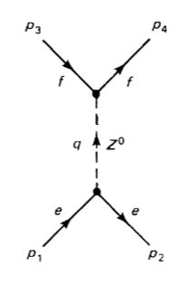
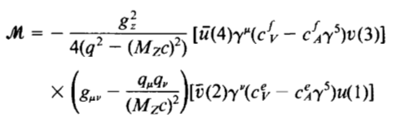


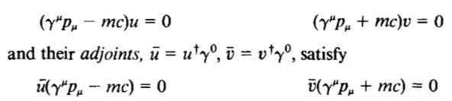

EXAMPLE Electron-Positron Scattering
Consider electron-positron scattering around Z0 pole
Because q is large, so we can neglect lepton
and quark mass, in this case, the second term is 0
From Dirac equation, we find

Slide 28
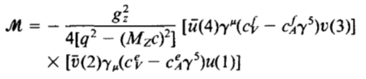
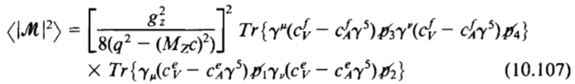
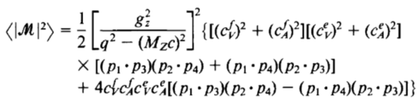
EXAMPLE Electron-Positron Scattering
The amplitude can be simplified as
Apply trace theorem

Slide 29



EXAMPLE Electron-Positron Scattering
In the CM frame
Finally, the differential cross section
And the total cross section

Slide 30



EXAMPLE Electron-Positron Scattering
As it shows, when 2E= Mc^2, it goes to infinity
But Z boson is not a stable particle, so it is not always on the mass shell so we can modify the propagator:
The cross section becomes
The correction term is negligible only when E=Mc^2

Slide 31



EXAMPLE Electron-Positron Scattering
In the previous chapter, we calculate the cross section of electron-positron scattering
Where Q denotes the charge, the only difference is the meditator, so we can write the ratio of the two process
Which has same products-muon

Slide 32



EXAMPLE Electron-Positron Scattering
The factor in the curly bracket is approximately 2 if we use the weak mixing angle, and if the energy is << Mc^2
The electromagnetic route dominates, but right on the Z pole
$ℏΓ_{z}$is around 2.5GeV, so the ratio is 200

Slide 33
Electroweak Unification

Slide 34
Chiral Fermion States
Glashow’s difficulty
1. Enormous disparity in strength between weak and electroweak interaction?
Because of the extremely massive mediator
2. Why the two mediators differ from each other so much?
Higgs mechanism
3. The structure difference between the vertex factors
Absorbing the matrix $1−γ^{5}$ into the particle spinor itself.

Slide 35




Chiral Fermion States
Specifically, we define
Chirality, which is different from “Helicity” we learned before,
It is easily to show that
If the particle is massless, $E=\left|P\right|c$
Where

Slide 36
EXAMPLE Electron-Positron Scattering
Consider electron-positron scattering around Z0 pole

Slide 37
EXAMPLE Electron-Positron Scattering
Consider electron-positron scattering around Z0 pole

